Slide 1

Coding Workshop Documentation
30.03.2026
Melissa Franke

Slide 2

Recap - Packages
Collections of functions
If there is a package applicable to your task, use it! -> time efficient
Beginner friendly:
Numpy, scipy, matplotlib, pandas, pingouin, seaborn
Packages have different learning curves
Coding Workshop
Documentation
Melissa Franke
M.Sc
0

Slide 3
How to get to know new packages
Ask local programmers in your area
Ask the internet how to do things
See something interesting in foreign code
Challenge yourself
-> find an appropriate package
Understand the package
Solve your problem
Documentation
Coding Workshop
Documentation
Melissa Franke
M.Sc
1

Slide 4
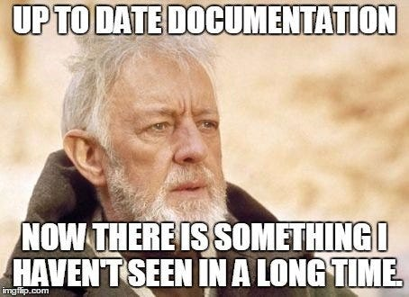
Documentation
Documentation is…
Written text
Images
Code comments
Important aspects of a Documentation can be:
Requirements: what do I need to run the code? Any dependencies? OS?
Architecture or design: how does it work? What is the underlying principle?
Technical: code comments, algorithm explanation, …
End user: manuals
Marketing: who is your group of interest
-> Make your code understandable to anyone!
Coding Workshop
Documentation
Melissa Franke
M.Sc
2

Slide 5
Application Programming Interface (API)
APIs are…
Connections between computers (Hardware/Software)
Connections between programs (Software)
Purpose:
APIs open software to connections from outside (in a controlled way)
APIs allow to use foreign code without integrating your code
Examples:
Fiji Macros
Igor – Python interface
Matlab - Matlab toolboxes
Downloadable Python packages
Coding Workshop
Documentation
Melissa Franke
M.Sc
3

Slide 6
Questions?

Slide 7
Documentation - Exercises
Hints:
Try searching like this:
How to do [] python
[] python
Good sources are:
Stackoverflow
Documentations
Github Gist
r/LearnPython
PyPI
If you need help, feel free to ask!
Exercise 1:
You all have been given a problem.
Try to find a python package that can solve it.
Coding Workshop
Documentation
Melissa Franke
M.Sc
4

Slide 8
Documentation - Exercises
Hints:
Try searching like this:
python [package name] documentation
Good sources are:
Python documentation
package website
ReadtheDocs
If you need help, feel free to ask!
Exercise 2:
You all have been given a function or package.
Your task is now to learn what the function or package does and how to use it.
You are also encouraged to try them out!
You have time until the end of the curse to become an expert and explain your function or package to the others
Coding Workshop
Documentation
Melissa Franke
M.Sc
5

Slide 9
Cheat Sheets and Vocabulary

Slide 10
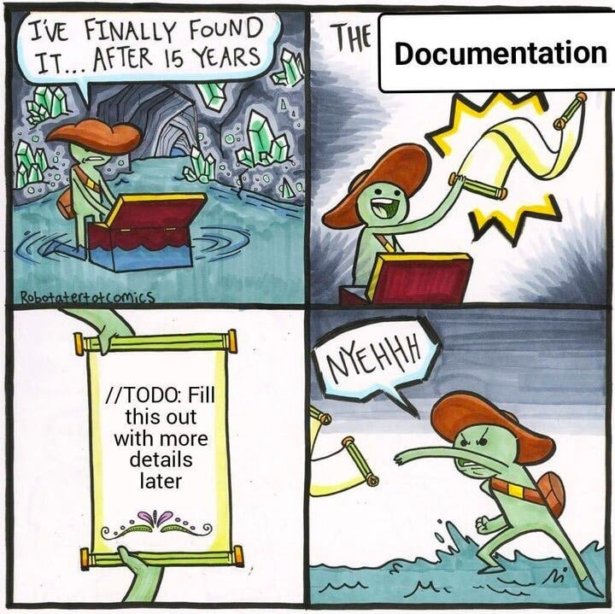
Documentations - cheat sheet
Good sources for help and information:
Documentations r/LearnPython
Stackoverflow W3 school (good for beginners)
GitHub Gist Geekforgeek (good for beginners)
Good sources for Documentation and APIs:
Package websites Trial and Error
ReadtheDocs
How to navigate all this:
Struggle. It is difficult.
Experience driven -> get a feeling what source is useful for you
Trial and Error -> see if what you found works for your style
Coding Workshop
Documentation
Melissa Franke
M.Sc
6

Slide 11
Documentations – Python Vocabulary
Documentation nomenclature
Parameter
Return
Method
Function
API nomenclature
function(x, y=None, z=1.0)
x - parameter that has to be given
y, z – parameters that are pre-defined and only optionally changed by the user
Classes, Subclasses, inheritance, …
Terms that are not explained in this curse. In a nutshell, these are containers that “hold” a multitude of related functions.
Functions of a class are accessed via the “.” character.
Class.function()
Similar like:
my_array.pop()
My_package.add()
my_list is an instance of a class List and pop() a function “contained” in this class.
Coding Workshop
Documentation
Melissa Franke
M.Sc
7

